Slide 1
Digital Communication 24EC2208
AY 2025-26
Sampling and Reconstruction

Slide 2
Sampling Theorem

Slide 3
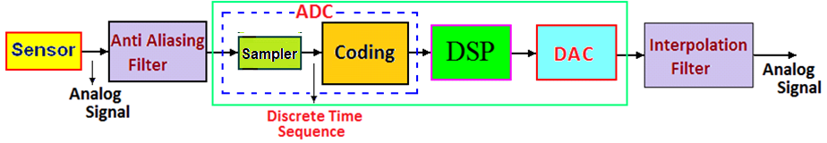
Digital Signal Processing System

Slide 4





Slide 5
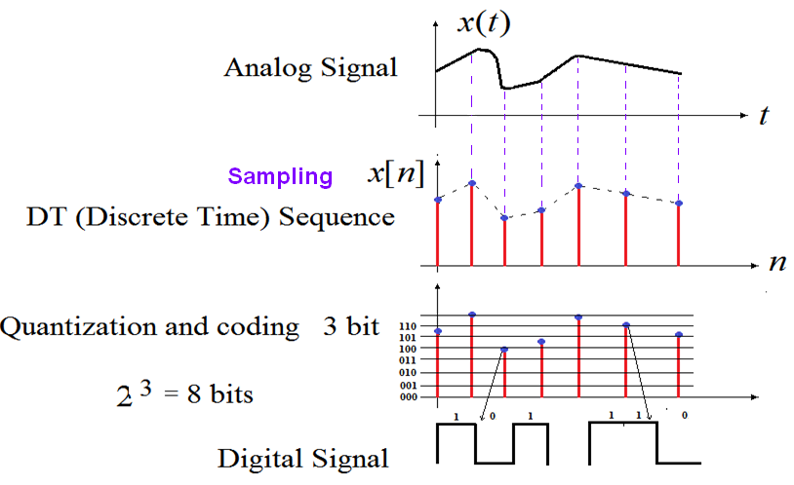
Analog, Discrete Time and Digital Signals

Slide 6
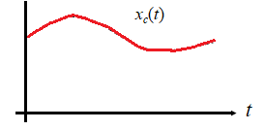
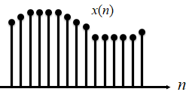
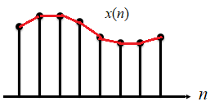
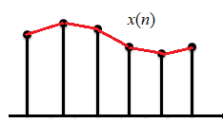
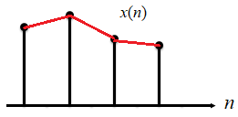
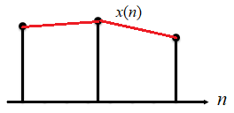
How many samples to be taken for given a signal,so that the original signal can recovered exactly?
Is there any rule?

Slide 7
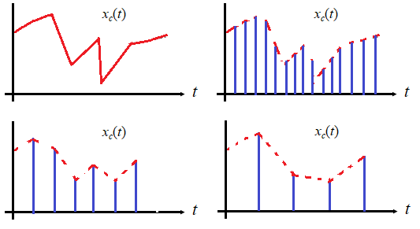
How many samples to be taken for given a signal,so that the original signal can recovered exactly?
Is there any rule?

Slide 8
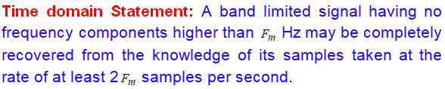
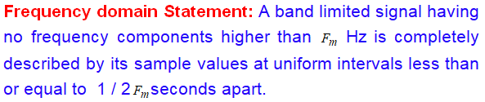
Uniform Sampling Theorem
The sampling theorem is significant in communication systems because it provides the basis for transmitting analog signals by use of digital techniques.

Slide 9
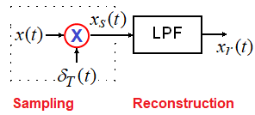
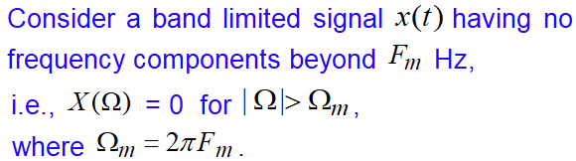
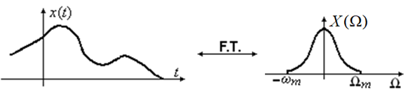

Slide 10









Slide 11
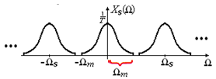




?

Slide 12
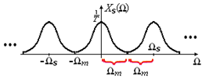


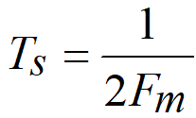


Slide 13
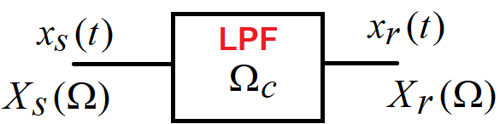




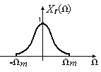
Signal Recovery from its samples

Slide 14
Under Sampling

Slide 15
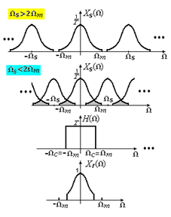

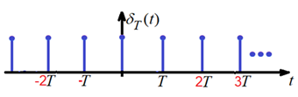
Under Sampling
Aliasing effect /
frequency folding effect

Slide 16
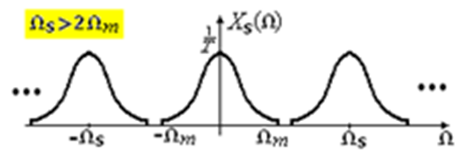

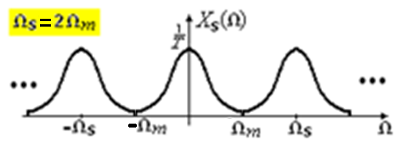

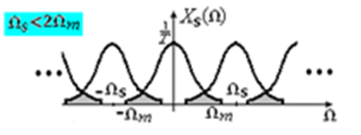

Over Sampling
Critical Sampling
Under Sampling
Aliasing

Slide 17

Uniform Sampling Theorem
In practice
In practice

Slide 18





Problems Discussion

Slide 19
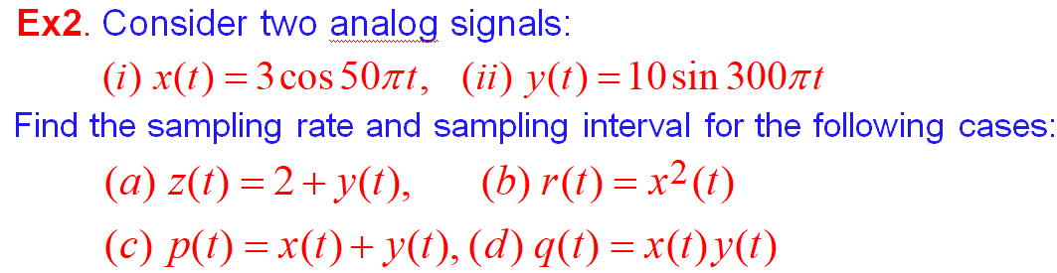








Slide 20







Slide 21
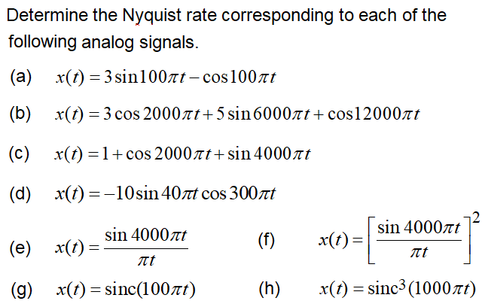

Slide 23
End

